Slide 1
Introduction to Agile
Lesson 1: Agile Process Framework

Slide 2
Lesson Objectives
Software Development Model and SDLC
“Waterfall Model” – An Overview
“Waterfall Model” – Advantages
“Waterfall Model” – Disadvantages
Agile Development Model
Graphical Illustration of Agile Development Model
Why use Agile?
Agile Manifesto and Principles
12 Principles of Agile Methods

Slide 3
Lesson Objectives
Agile Values
What is NOT an Agile software development?
Foundation of an Agile software development Method
Common Characteristics of Agile Methods
Agile Methods and Practices
When to use Agile Model?
Advantages of Agile Model
Difference between Agile and Waterfall Model
Agile – Myths and Reality
Agile Market Insight

Slide 4
1.1: Overview of Traditional Software Development Model Software Development Model and SDLC
Software development models are various processes or methodologies used to develop the product
Software developments models help improve the software quality as well as the development process in general
There exists various software development models and each one of them fulfill certain objectives of software development
Software Development Life Cycle (SDLC) is an environment that describes activities performed in each stage of the software development process
The SDLC contains detailed plan which basically describes how the development and maintenance of specific software is conducted
Most people involved with software development are very much familiar with the traditional software development methods like:
Waterfall or the sequential method
V-model
Notes:
Software Development Model and SDLC
A software application or an information system is designed to perform a particular set of tasks. Often, this set of tasks that the system will perform provides well-defined results, which involve complex computation and processing. Therefore it’s a very important and tedious job to administer the entire development process to ensure that the end product comprises of high degree of integrity and robustness, as well as user acceptance.
Software Development Life Cycle (SDLC) is a process of building or maintaining software systems. The SDLC process primarily takes care of various pre-development phases like requirement gathering, requirement analysis, design and architecture as well as post development activities like testing and validation. It also consists of the models and methodologies that development teams use to develop the software systems, which the methodologies form the framework for planning and controlling the entire development process.
Currently, there are two SDLC methodologies which are utilized by most system developers, namely the traditional development and agile development.
Most people involved with software development are very much familiar with the traditional software development methods like:
Waterfall or the sequential method
V-model

Slide 5
1.1: Overview of Traditional Software Development Model “Waterfall Model” – An Overview
The classic waterfall model was introduced in the 1970s by Win Royce
The Waterfall Model was the first Process Model to be introduced
It is also referred to as a linear-sequential life cycle model
The waterfall model is a sequential design process, often used in software development processes, in which progress is seen as flowing steadily downwards like a waterfall through the phases of SDLC
Every stage has to be completed separately at the right time so you can not jump stages
Documentation is produced at every stage of a waterfall model to allow people to understand what has been done
Testing is done at every stage
The waterfall approach assumes that requirements are stable and frozen across the project plan
However, this is usually not true in case of large projects where requirements may evolve across the development process
Notes:
Waterfall or Sequential Based Development Model
The waterfall model was very simple and logical in the way it approached software development and for these reasons alone it is still in use today. It takes very little time for anybody new to a development team or project to understand a sequential based process.
While it may be logical, one of its biggest problems was ensuring that the time spent in each phase didn't overrun into the next one resulting in a series of compounding delays. Unfortunately, this was the case more times than not and ultimately the testing phase got "squeezed" against the deadline, which became an immovable date.
Or if the project timelines are fixed then either parts of the original scope and functionality may not be delivered or even worse the functionality is delivered, but there is no time for sufficient testing and the quality of the product suffers.

Slide 6
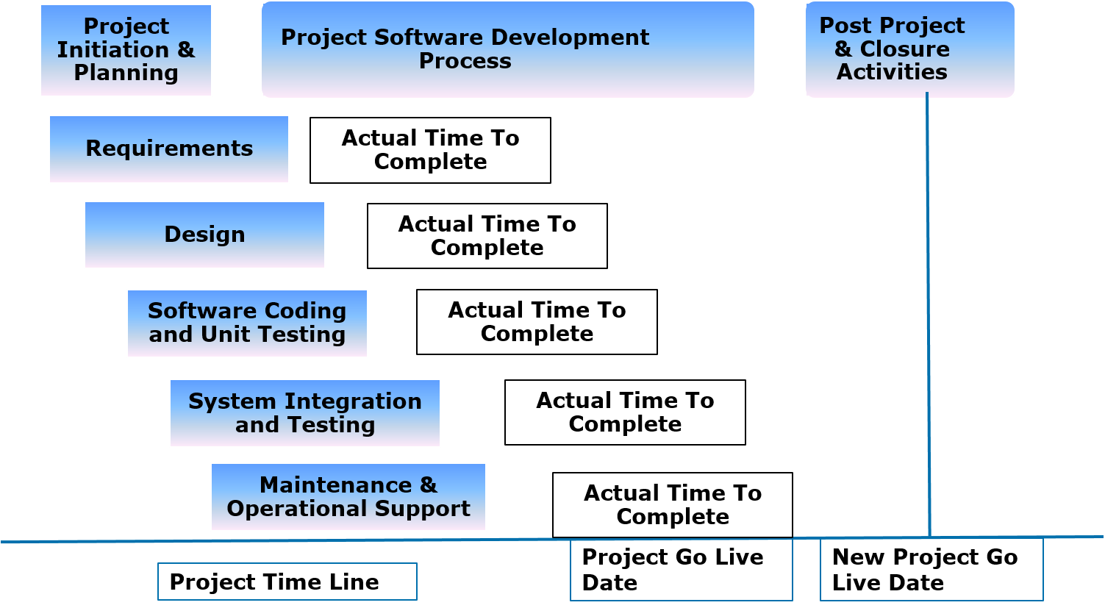
1.1: Overview of Traditional Software Development Model “Real Life” – Waterfall Model

Slide 7
1.1: Overview of Traditional Software Development Model “Waterfall Model” – Advantages
Simple and easy to understand and use
Easy to manage due to the rigidity of the model, each phase has specific deliverables and a review process
The project requires the fulfilment of one phase, before proceeding to next
Works well for smaller projects where requirements are very well understood
Various stages of the software development can be clearly defined in waterfall model
Well understood milestones
A schedule of activities can be created with deadlines for each stage of development
Product development progresses from vision, through design, implementation, testing, and ends up at operation and maintenance
Each phase of development proceeds in strict order
Notes:
“Waterfall Model” – Advantages
Waterfall model is simple to implement and also the amount of resources required for it are minimal. In this model, output is generated after each stage (as seen before), therefore it has high visibility. The client and project manager gets a feel that there is considerable progress. Here it is important to note that in any project psychological factors also play an important role.
Project management, both at internal level and client's level, is easy again because of visible outputs after each phase. Deadlines can be set for the completion of each phase and evaluation can be done from time to time, to check if project is going as per milestones.
This methodology is significantly better than the haphazard approach to develop software. It provides a template into which methods of analysis, design, coding, testing and maintenance can be placed.
This methodology is preferred in projects where quality is more important as compared to schedule or cost.

Slide 8
1.1: Overview of Traditional Software Development Model “Waterfall Model” – Disadvantages
Once an application is in the testing stage, it is very difficult to go back and change something that was not well-thought out in the concept stage
The customer can experience the working model of the product only at the end
Not suitable for complex & large projects
Only a certain number of team members will be qualified for each phase, which can lead at times to some team members being inactive
It is difficult to follow the sequential flow in software development process
Notes:
“Waterfall Model” – Disadvantages
The Waterfall model exhibits poor flexibility. The majority of software is written as part of a contract with a client, and clients are notorious for changing their stated requirements. Thus the software project must be adaptable, and spending considerable effort in design and implementation based on the idea that requirements will never change is neither adaptable nor realistic in these cases.
The waterfall model however is argued by many to be a bad idea in practice, mainly because of their belief that it is impossible to get one phase of a software product's lifecycle "perfected" before moving on to the next phases and learning from them. A typical problem is when requirements change midway through, resulting in a lot of time and effort wastage due to "Big Design Up Front".
Constant testing from the design, implementation and verification phases is required to validate the phases preceding them. Users of the waterfall model may argue that if designers follow a disciplined process and do not make mistakes that there is no need to constantly validate the preceding phases.

Slide 9
1.2: Agile Process Framework Agile Development Model
Agile development model is an amalgamation of iterative and incremental process models focusing more on process adaptability and customer satisfaction by rapid delivery of functional software product
Agile development model breaks the software into small incremental builds
These builds are provided in iterations
Each iterations lasts from about one to three weeks
Every iteration involves cross functional teams working simultaneously on various areas like planning, requirements analysis, design, coding, unit testing, and acceptance testing
At the end of the iteration a working product is displayed to the customer and important stakeholders
Notes:
Agile Development Model
Agile Development Model works on the basis of modern development approach which strongly believes that every project and every project needs are different. To attain the project success one needs to make an effort to tailored the existing methodologies to best suit the changing project requirements. In agile the tasks are divided to time boxes (small time frames) to deliver specific features for a release. Iterative approach is taken and working software build is delivered after each iteration. Each build is incremental in terms of features; the final build holds all the features required by the customer.
Agile thought process had started early in the software development and started becoming popular with time due to its flexibility and adaptability. The most popular agile methods include Rational Unified Process (1994), Scrum (1995), Crystal Clear, Extreme Programming (1996), Adaptive Software Development, Feature Driven Development, and Dynamic Systems Development Method (DSDM) (1995). These are now collectively referred to as agile methodologies, after the Agile Manifesto was published in 2001.

Slide 10
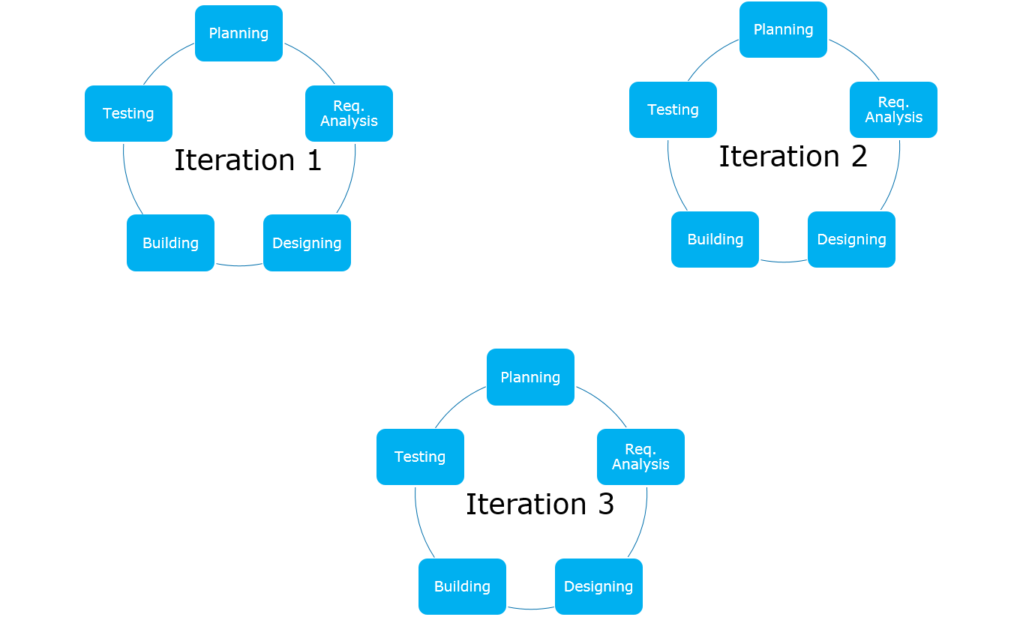
1.2: Agile Process Framework Graphical Illustration of Agile Development Model

Slide 11
1.2: Agile Process Framework Why use Agile?
Improved return on investment (RIO)
Early detection and cancellation of failing products
Higher quality software
Improved control of a project
Reduced dependence on individuals and increased flexibility
Notes:
Why use Agile?
Improved return on investment: This is the fundamental reason to use agile methods, and it's achieved in a number of different ways. In an agile project, the initial requirements are the baseline for ROI. If the project runs to completion with no changes, then the business will get the projected returns. However, by providing frequent opportunities for customer feedback, agile methods let customers steer the project incrementally, taking advantage of new insights or changed circumstances to build a better system and improve the ROI. By delivering working software early and often, agile projects also present opportunities for early deployment and provide earlier return on smaller initial investments.
Early cancellation of failing projects: It's common to observe projects to be on track for the first 80% or more of the schedule, only to be delayed for many months. In this situation sponsors face a difficult choice. Do they abandon the project after spending 80% of the budget or continue to fund the project in the hope of getting some return on the investment?
Higher quality: Of the four fundamental variables you can use to control a software development project, cost, time, scope and quality, most agile methods explicitly use scope as their control variable. All agile methods emphasize the production of high quality software, and extreme programming in particular adds a number of practices to support this objective.

Slide 12
1.2: Agile Process Framework Agile Manifesto and Principles
Individuals and interactions over processes and tools
Working software over comprehensive documentation
Customer collaboration over contract negotiation
Responding to change over following a plan
Notes:
Agile Manifesto and Principles
The agile manifesto is the result of a meeting at the Snowbird ski resort in Utah in 2001. Prior to that date, the individual agile processes were referred to as lightweight.
The release of the manifesto immediately gave the industry a tangible definition of agile and ground rules for adding new ideas in the future. The manifesto provides clear direction and is used to discuss and compare agile methodologies. The manifesto provides one common roof for all agilists, whatever their favorite agile methodology might be.
Here are the core values of the manifesto:
Individuals and interaction take precedence over processes and tools.
Working software takes precedence over comprehensive documentation.
Customer collaboration takes precedence over contract negotiation.
Responding to change takes precedence over following a plan.
Please note that the left side of each statement is valued more than the right side. What is important and often misunderstood is that the manifesto does not recommend neglecting the values of the right side - for example, project documentation. It simply means that the values on the left are valued more highly. Every agile project team has to find the right balance as a team, but also they must find balance within the organization.

Slide 13
1.2: Agile Process Framework 12 Principles of Agile Methods
According to Kent Beck, the Agile Manifesto is based on twelve principles:
Customer satisfaction by rapid delivery of useful software
Welcome changing requirements, even late in development
Working software is delivered frequently (weeks rather than months)
Working software is the principal measure of progress
Sustainable development, able to maintain a constant pace
Close, daily cooperation between business people and developers
Face-to-face conversation is the best form of communication (co-location)
Projects are built around motivated individuals, who should be trusted
Continuous attention to technical excellence and good design
Simplicity—the art of maximizing the amount of work not done - is essential
Self-organizing teams
Regular adaptation to changing circumstances
Notes:
The Principles of Agile Methods – www.agilemanifesto.org
Our highest priority is to satisfy the customer through the early and continuous delivery of valuable software.
Welcome changing requirements, even late in development. Agile processes harness change for the customer's competitive advantage.
Deliver working software frequently, from a couple of weeks to a couple of months, with a preference to the shorter timescale.
Business people and developers must work together daily throughout the project.
Build projects around motivated individuals. Give them the environment and support they need, and trust them to get the job done.
The most efficient and effective method of conveying information to and within a development team is face-to-face conversation.
Working software is the primary measure of progress.
Agile processes promote sustainable development. The sponsors, developers, and users should be able to maintain a constant pace indefinitely.
Continuous attention to technical excellence and good design enhances agility.
Simplicity--the art of maximizing the amount of work not done--is essential.
The best architectures, requirements, and designs emerge from self-organizing teams.
At regular intervals, the team reflects on how to become more effective, then tunes and adjusts its behavior accordingly.

Slide 14
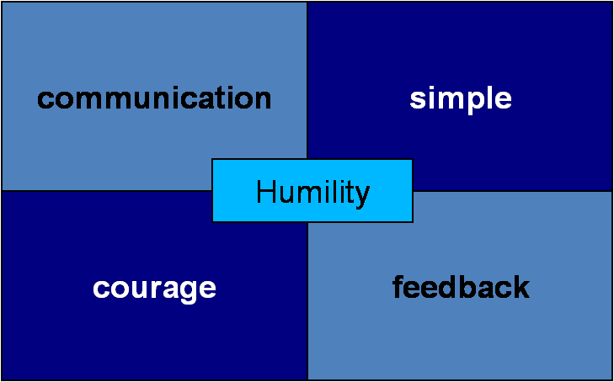
1.2: Agile Process Framework Agile Values
Notes:
The five values of Agile Modelling (AM) are:
Communication: Models promote communication between your team and your project stakeholders as well as between developers on your team.
Simplicity: It’s important that developers understand that models are critical for simplifying both software and the software process, it’s much easier to explore an idea, and improve upon it as your understanding increases, by drawing a diagram or two instead of writing tens or even hundreds of lines of code.
Feedback: Kent Beck says it best in Extreme Programming Explained “Optimism is an occupational hazard of programming, feedback is the treatment.” By communicating your ideas through diagrams, you quickly gain feedback, enabling you to act on that advice.
Courage: Courage is important because you need to make important decisions and be able to change direction by either discarding or refactoring your work when some of your decisions prove inadequate.
Humility - The best developers have the humility to recognize that they don't know everything, that their fellow developers, their customers, and in fact all project stakeholders also have their own areas of expertise and have value to add to a project. An effective approach is to assume that everyone involved with your project has equal value and therefore should be treated with respect. Huet Landry suggests the concept of "Other Esteem", instead of "Self Esteem", where you treat the opinions of others as if they have more value than yours. With this approach your first reaction to another's idea will be most positive.

Slide 15
1.2: Agile Process Framework What is NOT an Agile software development?
Compressing the project schedule
Eliminating all existing software development models
Eliminating all documentation
Writing code up to the last minute
An excuse for doing nothing
Notes:
What is NOT an Agile software development?
While there are many different definitions of what Agile Software Development is, there are reasons why each of the quoted sources view Agile in different ways. The term Agile is used to describe a software development approach that embodies the statements made in Agile Manifesto and follows the “12 Principles of Agile Methods”.
Many software development group says that they are using agile methods, but calling the development approach Agile doesn’t actually make it AGILE.
If you have implemented any of the above as part of your agile development approach, then you might need to rethink what agility actually is.

Slide 16
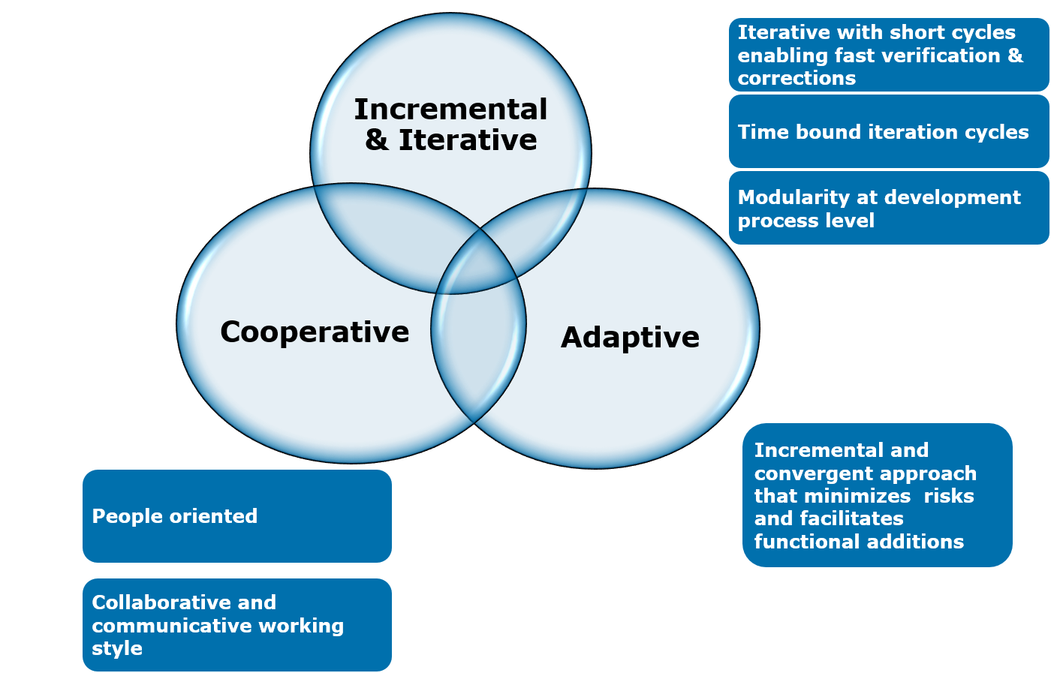
1.2: Agile Process Framework Common Characteristics of Agile Methods

Slide 17
1.2: Agile Process Framework Agile Methods and Practices
Scrum - Ken Schwaber, Jeff Sutherland, Mark Beedle
Extreme Programming (XP) - Kent Beck, Eric Gamma, and others
Dynamic System Development Method (DSDM) - Dane Faulkner And others
Agile Unified Process (or Agile RUP) - Scott Ambler
Feature Driven Development - Peter Coad and Jeff Deluca
Lean Software Development - Mary and Tom Poppendieck
Kanban - David Anderson
Notes:
The term 'agile' is a philosophy and is a conceptual framework for undertaking software engineering projects. Most agile methods attempt to minimize risk by developing software in short time boxes, called iterations. Each iteration is like a miniature software project of its own, and includes all of the tasks necessary to release the mini increment of new functionality planning, requirements analysis, design, coding, testing and documentation. While an iteration may not add enough functionality to warrant releasing the product, an agile software project intends to be capable of releasing new software at the end of every iteration. Under this broad umbrella sits many more specific approaches.
Some of the well-known agile software development methods are given below.
Scrum - Ken Schwaber, Jeff Sutherland, Mark Beedle
Extreme Programming (XP) - Kent Beck, Eric Gamma, and others
Dynamic System Development Method (DSDM) - Dane Faulkner And others
Agile Unified Process (or Agile RUP) - Scott Ambler
Feature Driven Development - Peter Coad and Jeff Deluca
Lean Software Development - Mary and Tom Poppendieck
Kanban - David Anderson

Slide 18
1.2: Agile Process Framework When to use Agile Model?
This model can be followed when:
New changes must be implemented. The freedom agile gives to change is very important. New changes can be implemented at very little cost because of the frequency of new increments that are produced.
To implement a new feature, the developers need to lose only the work of a few days, or even only hours, to roll back and implement it.
Unlike the Waterfall Model, in the agile model, limited planning is required to get started with the project. Agile assumes that the end users’ needs are ever changing in a dynamic business and IT world. Changes can be discussed and features can be newly effected or removed based on feedback. This gives the customer the finished system they want or need.
Both system developers and stakeholders alike, find that they also get more freedom of time and options than if the software was developed in a more rigid, sequential manner. Having options gives them the ability to leave important decisions until more or better data or even entire hosting programs are available; meaning the project can continue to move forward without fear of reaching a sudden standstill.

Slide 19
1.2: Agile Process Framework Advantages of Agile Model
Is a very realistic approach to software development
Promotes teamwork and cross training
Functionality can be developed rapidly and demonstrated
Resource requirements are minimum
Suitable for fixed or changing requirements
Delivers early partial working solutions
Good model for environments that change steadily
Minimal rules, documentation easily employed
Enables concurrent development and delivery within an overall planned context
Little or no planning required
Easy to manage
Gives flexibility to developers

Slide 20
1.2: Agile Process Framework Difference between Agile and Waterfall Model
Agile
Software development lifecycle is carried out in the form of Sprints
Agile method proposes incremental and iterative approach to software design
It follows an incremental approach towards solution development
Agile methodology is known for its flexibility
Agile can be considered as a collection of many different projects
Waterfall
Software development process is divided into distinct phases
Development of the software flows sequentially from start point to end point
It follows linear, sequential design approach towards software development
Being a traditional software development model, Waterfall exhibits characteristic of a structured model so most of the times it can be very rigid
Software development will be completed as one single project

Slide 21
1.2: Agile Process Framework Agile – Myths and Reality
Myth
No Documentation
Undisciplined
No Planning
Not Predictable
Is a Fad
Silver Bullet
RUP isn’t agile
Not Fixed Price
Reality
Agile Documentation
Requires great discipline
Just-in-time (JIT) planning
Far more predictable
It’s quickly becoming the norm
It requires skilled people
RUP is as agile as you make it
Agile provides stakeholders control over the budget, schedule, and scope

Slide 22
Summary
In this lesson, you have learnt
Various conventional software development models like Waterfall Model, SDLC & V-Model
The traditional software development models like Waterfall Model, V-Model are classified into the heavyweight methodologies
These methodologies are based on progressive series of steps like requirements definition, design and architectural planning, development and testing
Every traditional software development model has its own advantages and disadvantages
We need to select the software development model which best suits our project requirement
Introduction to Agile
Agile Manifesto and Principles
Agile Values
Agile – Myths and Reality
Notes:
Add the notes here.

